Slide 1
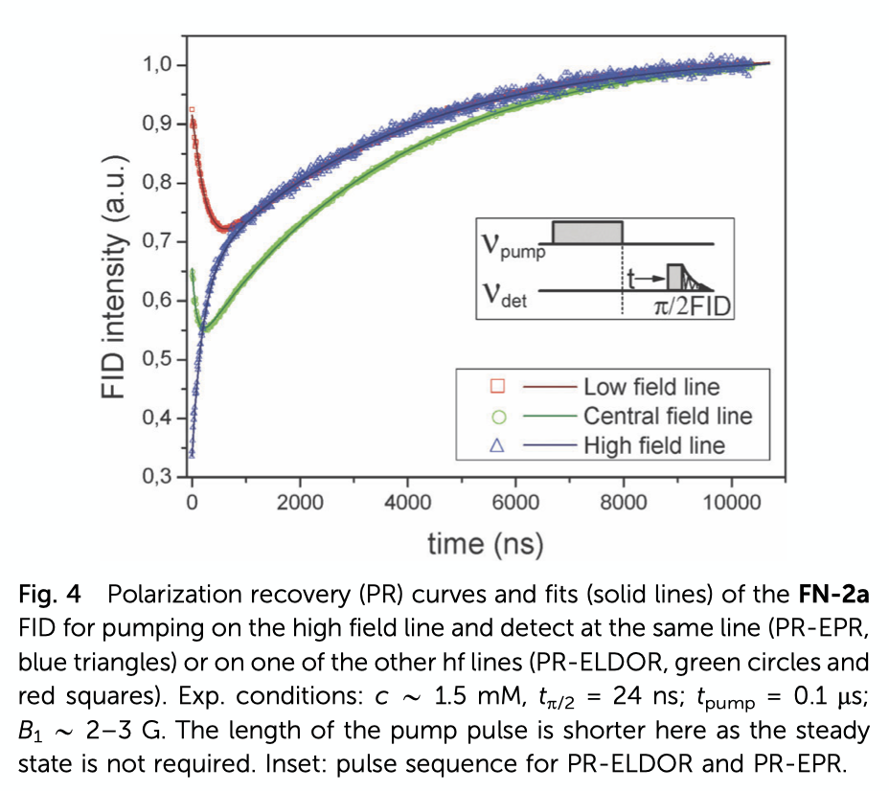

Slide 2
Detecting on central peak
Pumping on central peak
5mM 4OH-TEMPO
0.1 D-gly = 0.1 mole fraction of deuterated glycerol in water
0.5 D-gly = 0.5 mole fraction of deuterated glycerol in water
Pumping on low field peak
Pumping on high field peak

